Slide 1
Creating Business Value through Data Presentation
Introduction to Analyzing Data for Business Goals

Slide 2
Learning Goals
Assess different data visualization techniques and discuss their advantages and limitations.
Decide on a method to validate, prepare, and communicate insights to key stakeholders.
Organize data using a pivot table in Excel.
Describe the process of data manipulation and techniques using Excel.

Slide 3
Data Manipulation
Data: collection of facts representing business transactions, experiences, observations, or experiments
Data may come in a variety of forms
Numbers, letters, words, images, vides, audio files
Data is the lowest level of abstraction to create information and knowledge
Data - Information - Knowledge
Data is the raw material for business analytics
“Data is the new oil”

Slide 4
Common Data Types
Structured data
Numerical [continuous] data
Interval
Ratio
Categorical [discrete] data
Nominal
Ordinal
Unstructured [less structured] data
Textual data
Multimedia data (Image, video, audio)
XML/HTML/JSON
Data
Mining
Text
Mining
Media
Mining
Web
Mining

Slide 5
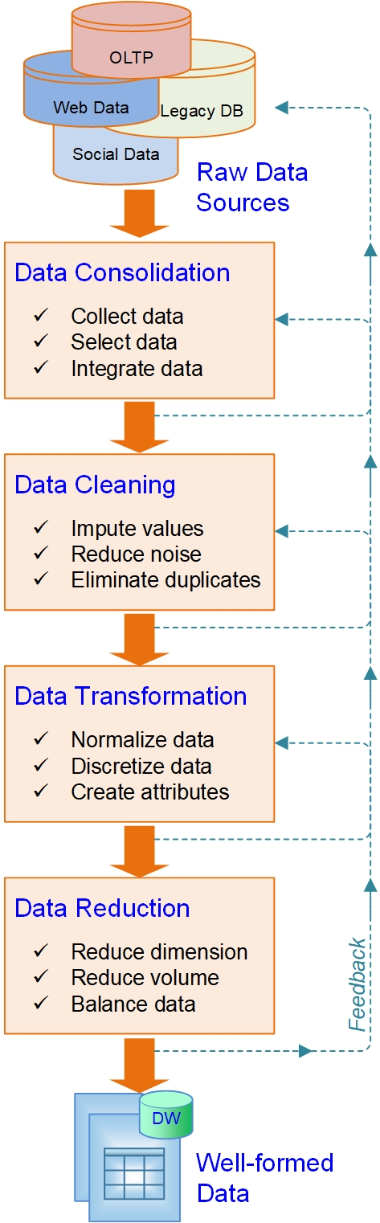
Preprocessing of Data for Analytics
The raw data is
Dirty…
Noisy…
Incomplete…
Inconsistent…
Inaccurate…
The GIGO principle
It is a time demanding, multi-step, recursive, and tedious process

Slide 6
Summary of Data Preprocessing Tasks
Main Task | Subtasks | Popular Methods
Data consolidation | Access and collect the data | SQL queries, software agents, Web crawlers, data access APIs
 | Select and filter the data | Domain expertise, SQL queries, statistical tests
 | Integrate and unify the data | SQL queries, domain expertise, ontology-driven data mapping
Data cleaning | Handle missing values in the data | Filling in the missing values (imputations); recoding of the missing values with a constant such as “ML”; removal of the records; etc.
 | Identify and reduce noise in the data | Identification of outliers in data with simple statistical techniques or with cluster analysis; removal of the outliers or smoothing by using binning, regression, or simple averages
 | Find and eliminate erroneous data | Identification of erroneous values in data, such as odd values, inconsistent class labels, odd distributions; use of domain expertise to correct the values or remove the records
Data transformation | Normalize the data | Reduction of the range of values in each numerically valued variable to a standard range (e.g., 0 to 1, -1 to +1) by using a variety of normalization or scaling techniques
 | Discretize or aggregate the data | If needed, conversion of the numeric variables into discrete representations using range- or frequency-based binning techniques; for categorical variables, reduction of unique values
 | Construct new attributes | Derivation of new and more informative variables from the existing ones, using a range of mathematical functions (addition and multiplication or complex combination of transformations)
Data reduction | Reduce number of attributes | Principal component analysis, independent component analysis, chi-square testing, correlation analysis, decision tree induction
 | Reduce number of records | Random sampling, stratified sampling, expert knowledge-driven purposeful sampling
 | Balance skewed data | Oversampling of the less represented or undersampling of the more represented class records

Slide 7
Demo: Tools & Techniques
Topics
Pivoting
Shaping
Grouping

Slide 8
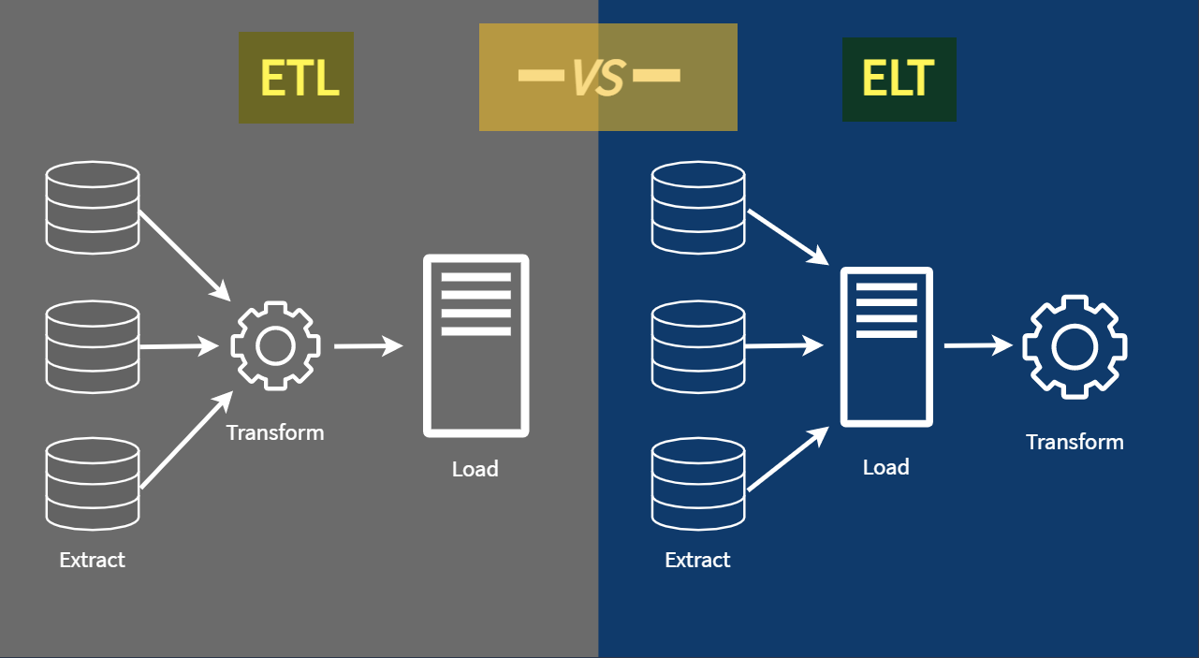
ETL VS ELT

Slide 9
Data Visualization
Here are a set of simple steps for selecting appropriate data visualization:
Step 1: Identify your audience.
Step 2: Identify questions to be answered by your visualization.
Step 3: Think of possible constraints or challenges (e.g., budget limitations, the speed at which the study can be completed, or the dependability of your data) and ask the following questions:
Is my data reliable?
Is the value of the analysis greater than the cost?
How will I store my data?
Is the data owned or controlled by someone else?
Step 4: Select the appropriate visualization.

Slide 10
Data Visualization
Advantages and Limitations
Reporting, Monitoring, and Deciding

Slide 11
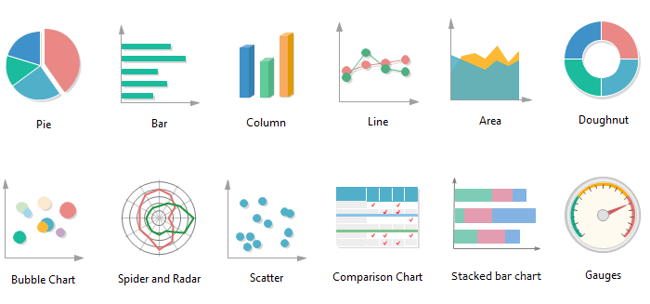
Data Visualization - Tools & Techniques
Types of charts
Image credit: https://medium.com

Slide 12
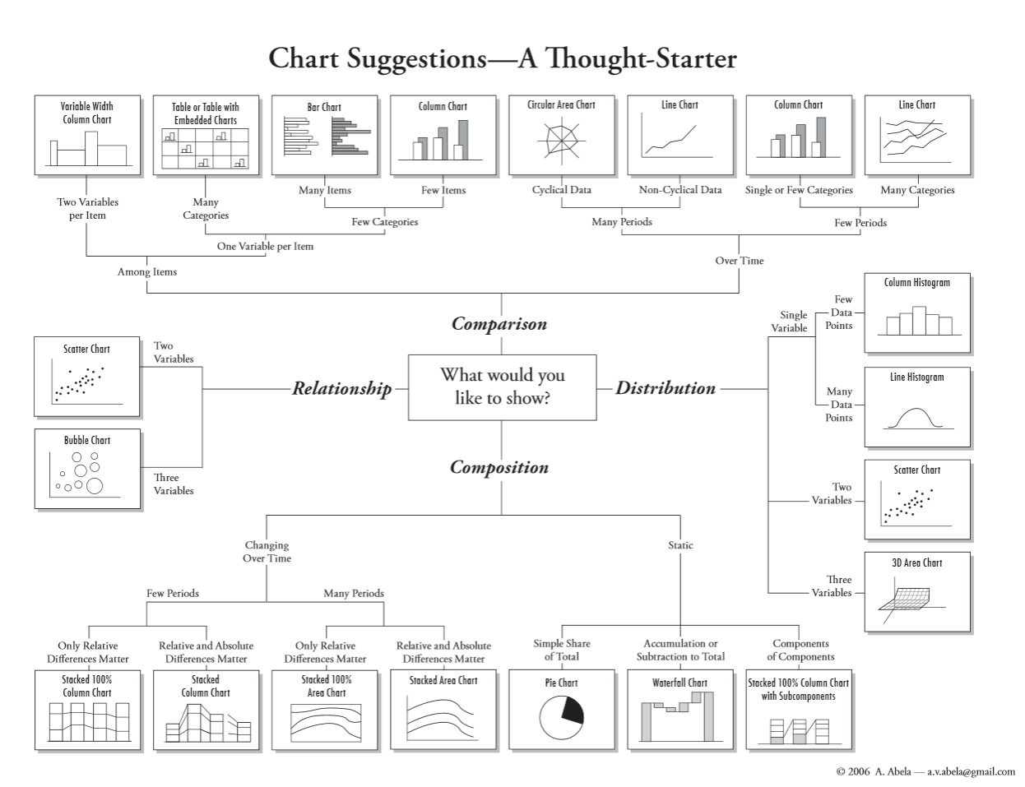
Data Visualization – The right tool for the job

Slide 13
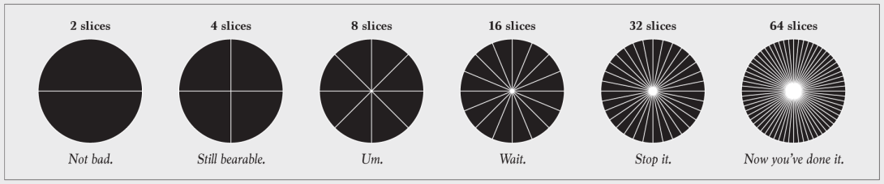
Pie Chart
What is "too many" slices though?
That's a judgement call, but if it's hard to tell that one slice represents twice the value as another or smaller slices start to look the same, it's time to scale back.
Consider clumping the smaller categories into a larger "Other" group.
The same goes for donut charts.

Slide 14
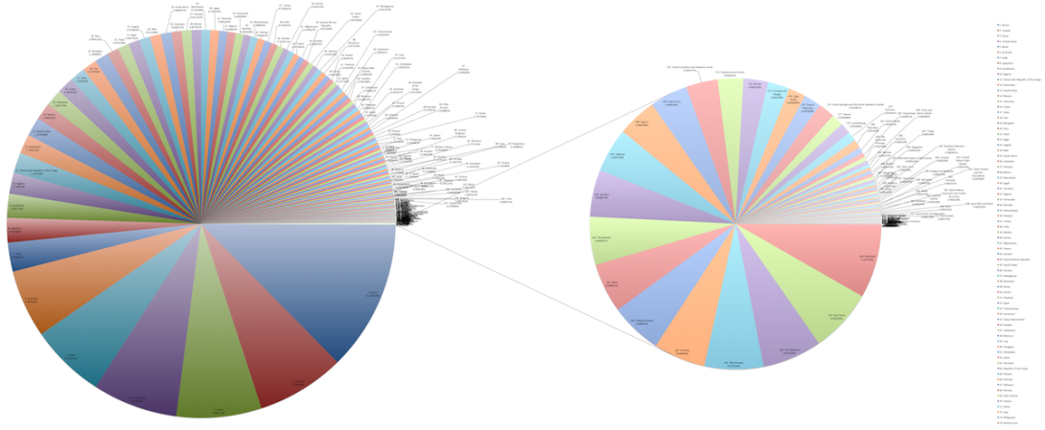
Pie Chart
Example
This set of pie charts comes by way of Wikipedia, and it shows the areas of countries.
Notes:
The chart on the left already has a lot of slices, but then there's a breakout pie chart for smaller countries that provides even more. There are a lot of ways to go about showing this data, such as a treemap, properly scaled symbols, or just a regular map. The meager pie chart just isn't built for datasets that are more than a handful of values.

Slide 15
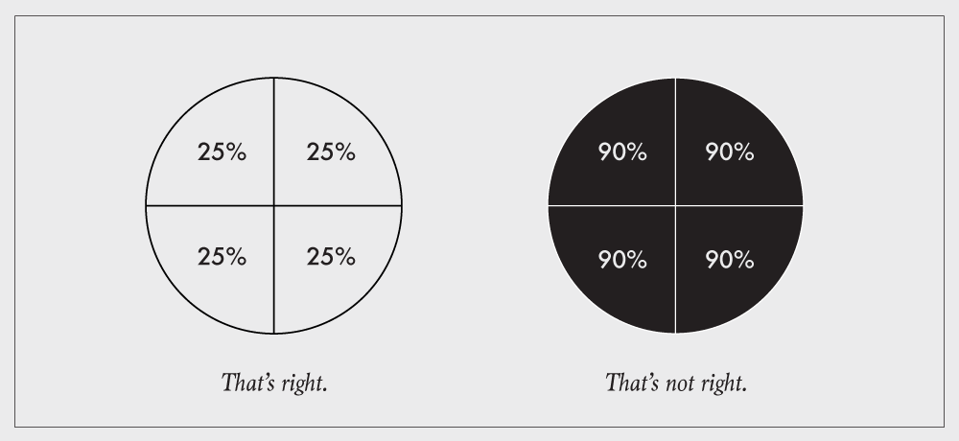
Respect the parts of a whole
Charts that represent parts of a whole should be used to show data that represents parts of a whole.
This includes stacked bar charts, stacked area graphs, treemaps, mosaic plots, donut charts, and pie charts.
Each section in these charts represents a separate, non-overlapping proportion.

Slide 16
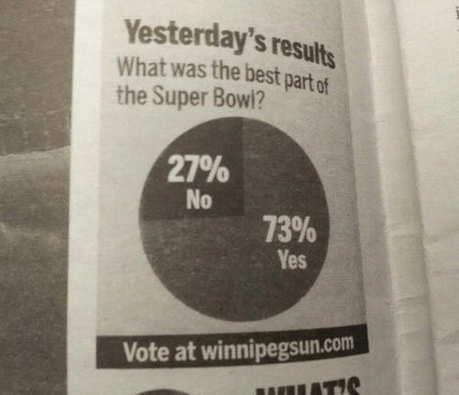
What is the question?

Slide 17
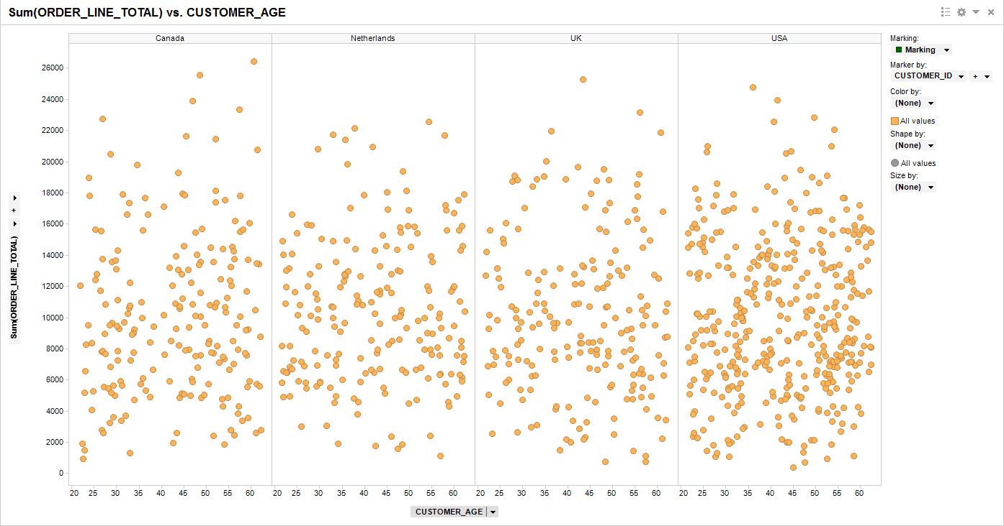
Scatter Plot: What is the story here?

Slide 18
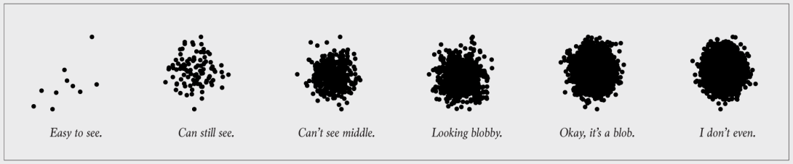
Scatter Plot: Say What?
This is the point of visualization. If you don't show the data, it defeats the purpose of the chart.
This often happens when you show too much data at once, and you obscure the area of interest.

Slide 19
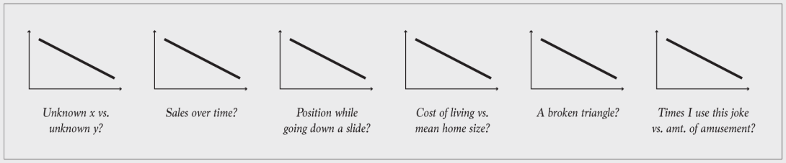
Line Chart: You have some explaining to do
When you "show the data", you encode it to shapes, colors, and geometries.
Need to the ability to decode back to the values. The classic example is unlabeled axes.
Sometimes encodings don't need to be explained. For example, your audience likely knows how to read a bar chart, so you don't have to explain that bar length represents values. But you do need to explain the data, namely the units and the subject at hand.

Slide 20
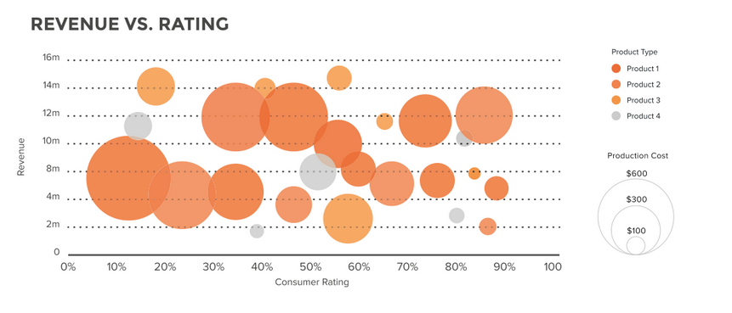
Bubble Plot

Slide 21
Final Project Check in

Slide 22
Application Case:
Breakout rooms with small groups
How to solve the “Oil Spill” crises
Be prepared to share your summary with the class in about 30 minutes

Slide 23

Welcome to your new office

Slide 24
Background
Each blow costs the Oil and Gas industry a Billion dollars
Can we avoid it? Can we see it coming and take action?
Each operating rig consists of thousands of sensors
Sensor data can be used to analyze and reduce HSE (Health, Safety and Environment) risk considerably

Slide 25
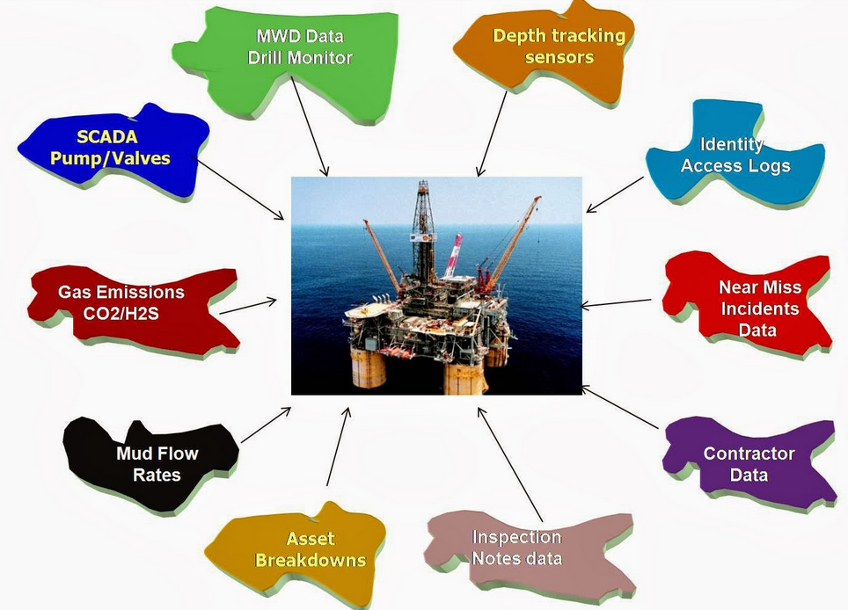
Data Sources

Slide 26

Q&A
What questions and comments do you have?

